Slide 1
IT- 4201 Human Computer Interaction
Lecture # - 1

Slide 2
About Me
Mehrin Anannya
Lecturer,
Jahangirnagar University

Slide 3
Contents
Reference Books
Reference Slides
Human Computer Interaction (HCI)
Importance of HCI
Why do we do HCI in CSE?
HCI is an extension of traditional CS disciplines
Principles of HCI

Slide 4
Reference Books
TextBook
ALAN DIX, JANET FINLAY, GREGORY D. ABOWD, RUSSELL BEALE, HUMAN–COMPUTER INTERACTION, 3rd Edition, Pearson, 2004
Gerard Jounghyun Kim, Human–Computer Interaction: Fundamentals and Practice, CRC PressTaylor & Francis Group, 2015
Related
I. Scott MacKenzie, Human–Computer Interaction: An Empirical Research Perspective, Morgan Kaufmann, 2013

Slide 5
Reference Slides
Lecture Slides by ALAN DIX, JANET FINLAY, GREGORY D. ABOWD, RUSSELL BEALE : https://hcibook.com/e3/chapters/
Free slides available in the Internet

Slide 6
Human Computer Interaction (HCI)
Human–computer interaction (HCI) is a cross-disciplinary area (e.g., engineering, psychology, ergonomics, design) that deals with the theory, design, implementation, and evaluation of the ways that humans use and interact with computing devices.
Interaction is a concept to be distinguished from another similar term, interface.
Interaction refers to an abstract model by which humans interact with the computing device for a given task, and an interface is a choice of technical realization (hardware or software) of such a given interaction model.
Thus, the letter I in HCI refers to both interaction and interface, encompassing the abstract model and the technological methodology (next slide-Figure 1.1).

Slide 7
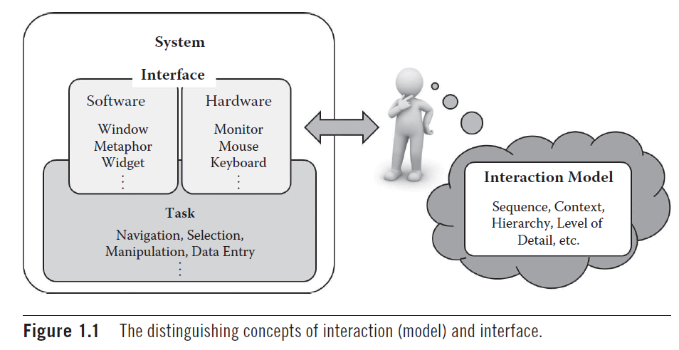
Human Computer Interaction (HCI) (cont.)

Slide 8
Importance of HCI
The early focus of HCI has been in how to design interaction and implement interfaces for high usability means the resulting interfaces are easy to use, efficient for the task, ensure safety, and lead to a correct completion of the task.
Usable and efficient interaction with the computing device in turn translates to higher productivity which is now a critical added requirement for commercial success as well.
Apple® products is a good example which are attractive and have created a multitude of faithful followers even though their functionality may be virtually equal to their competitors.
In this context, the concept of user experience (UX) has lately become a buzzword, a notion that not only encompasses the functional completeness, high usability, and aesthetic appeal of the interactive artifact, but also its seamless integration into one’s lifestyle or even creating a new one around it (next slide-Figure 1.2).

Slide 9
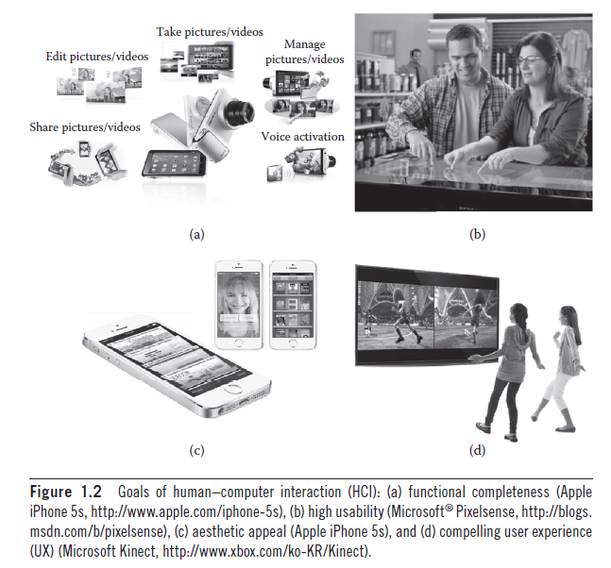
Importance of HCI (cont.)

Slide 10
Importance of HCI (cont.)
A less acknowledged fact is how HCI has had a huge impact in the history of computing and changed our daily lives. It was probably the invention (or rediscovery) of the mouse that was the linchpin in the personal computer revolution, making the operation of a computer intuitive and much easier than the previous system of keyboard commands.
Ex. Spreadsheet interface for business computing, Web-browser interface, Smartphones, with their touch-oriented interfaces, Body-based and action-oriented interfaces for playing computer games.

Slide 11
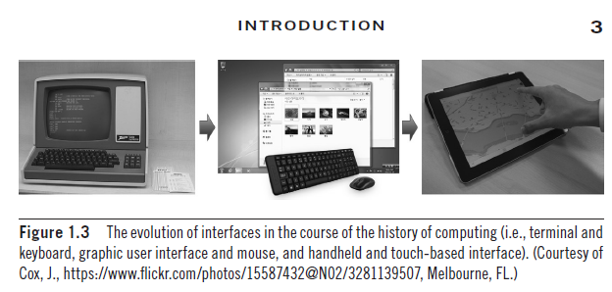
Importance of HCI (cont.)
HCI still continues to redefine how we view, absorb, exchange, create, and manipulate information to our advantage (Figure 1.3).

Slide 12
Why do we do HCI in CSE?
Every engineering discipline includes the study of breakdowns and the design of improved / or new solutions that address those breakdowns

Slide 13
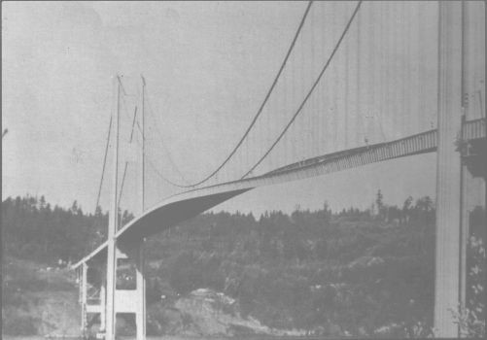
Why do we do HCI in CSE? (cont.)
Tacoma Narrows (nicknamed “Galloping Gertie”)

Slide 14

Why do we do HCI in CSE? (cont.)
Tacoma Narrows (nicknamed “Galloping Gertie”)

Slide 15
2-minute activity
Can you find a technology analogue to the collapse of the Tacoma bridge?

Slide 16


Slide 17
Why do we do HCI in CSE? (cont.)
Understanding how and why human interaction breaks down is fundamental to designing better computing systems
This study must include computer scientists, as we are the ones creating the technology

Slide 18
HCI is an extension of traditional CS disciplines
We design, scale, and evaluate computing systems for particular tasks (e.g., parallel programming, network routing)
HCI incorporates humans into the computing system
Humans as an additional constraint
Any computer system must be designed taking into account
the physical constraints of the machine (e.g., processor speed, networking capabilities)
the human physical and mental constraints (e.g., attention, memory)
(should we add, social level constraints?)
http://www.pgbovine.net/what-is-hci-research.htm

Slide 19
Principles of HCI
“Know Thy User”
Understand the Task
Reduce Memory Load
Strive for Consistency
Remind Users and Refresh Their Memory
Prevent Errors/Reversal of Action
Naturalness

